Slide 1

Defining Your Own Classes
Part - I

Slide 2
Learning Outcomes
Defining and using a class
Know about how to define class members (fields, methods and constructors)
Experience in different types of parameter passing and return types in declaration of methods
Know about how to define constructors and overloading constructors
Distinguish private and public methods
Distinguish private and public data members
Pass primitive data and objects to a method

Slide 3
What is a Class?
A class is a template that defines the form of an object.
It specifies both the data and the method that will operate on that data.
It is a logical abstraction and blueprint that resides in the Java class file.

Slide 4
What is a Class?
It has fields: variables with certain data types. Some data are associated with each individual object, called instance variables. Other data are associated with each class, called class variables, which are identified by keyword “static”.
It has methods: the actions that act on those data. The methods also have two types. Instance methods are associated with each object, and class methods (identified as “static”) are associated with the whole class.

Slide 5
Template for Class Definition
Import Statements
Class Comment
class
{
Class Name
Data Members
Methods
(incl. Constructor)
}
Notes:
This is the template we use when creating programmer-defined classes.

Slide 6
Why Programmer-Defined Classes
Using just the String, GregorianCalendar, JFrame and other standard classes will not meet all of our needs. We need to be able to define our own classes customized for our applications.
Learning how to define our own classes is the first step toward mastering the skills necessary in building large programs.
Classes we define ourselves are called programmer-defined classes.

Slide 7
Example : Student Class
public class Student {
static int age; // field or data member
static String name;
Student(String n) { // constructor
name = n;
}
void setAge(int num) { // method
age = num;
}
public static void main(String[] args) {
Student stud = new Student("Aung Aung"); // creating Student object with new keyword
stud.setAge(20);
System.out.println (name + " is now " + age);
}
}

Slide 8
Example: Using the Bicycle Class
class BicycleRegistration {
public static void main(String[] args) {
Bicycle bike1, bike2;
String owner1, owner2;
bike1 = new Bicycle( ); //Create and assign values to bike1
bike1.setOwnerName("Adam Smith");
bike2 = new Bicycle( ); //Create and assign values to bike2
bike2.setOwnerName("Ben Jones");
owner1 = bike1.getOwnerName( ); //Output the information
owner2 = bike2.getOwnerName( );
System.out.println(owner1 + " owns a bicycle.");
System.out.println(owner2 + " also owns a bicycle.");
}
}
Notes:
This sample program shows the main class BicycleRegistration is using the Bicycle class. This Bicycle class is not part of any standard packages. It is something we (or other programmers) have to define ourselves.

Slide 9
The Definition of the Bicycle Class
class Bicycle {
// Data Member
private String ownerName;
//Constructor: Initialzes the data member
public void Bicycle( ) {
ownerName = "Unknown";
}
//Returns the name of this bicycle's owner
public String getOwnerName( ) {
return ownerName;
}
//Assigns the name of this bicycle's owner
public void setOwnerName(String name) {
ownerName = name;
}
}

Slide 10
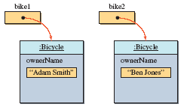
Multiple Instances
Once the Bicycle class is defined, we can create multiple instances.
Bicycle bike1, bike2;
bike1 = new Bicycle( ); bike1.setOwnerName("Adam Smith");
bike2 = new Bicycle( ); bike2.setOwnerName("Ben Jones");
Notes:
Once a class is defined, we can create multiple instances of the class as shown by this example. Notice how all the instances have their own copy of data members.

Slide 11
Data Member Declaration
<modifiers> <data type> <name> ;
Modifiers
Data Type
Name
private String ownerName ;
field declarations can be preceded by different modifiers
access control modifiers (private, package (default), protected, public)
static
final
primitive data type vs. Object reference
Boolean, char, byte, short, int, long, float, double , Student, Pen

Slide 12
Access Control Modifier
private ‒ private members are accessible only in the class itself
package(default) ‒ package members are accessible in classes in the same package and the class itself. It can’t be accessed from outside of the package.
protected ‒ protected members are accessible in classes in the same package, and outside of the package through child class.
public ‒ public members are accessible anywhere the class is accessible

Slide 13
Static and Instance Variables
Static Variables
only one copy of static field exists, shared by all objects of this class and can be accessed directly in the class itself.
access from outside the class must be preceded by class name as follows or via an object belonging to the class.
static int id = 10;
System.out.println(Student.id++);
Instance Variables
from outside the class, non-static fields must be accessed through an object reference

Slide 14
Methods – Declaration
<modifier> <return type> <method name> ( <parameters> ){
<statements>
}
Modifier
Return Type
Method Name
Parameter
public void setOwnerName ( String name ) {
ownerName = name;
}
Statements

Slide 15
Methods – Return Values
<modifier> <return type> <method name> ( <parameters> ){ }
The return type of a method can be one of the followings:
Parameter Types | Format | Example
Primitive Data Types | int, float, double, char, string, etc. | double method_name( ) { … }
Objects | Student, Point, etc. | Student method_name( ) { … }
Arrays or collection types | int [], float [] | int[] method_name( ) { … }
No return | void | void method_name( ) { … }

Slide 16
Methods – Parameters
<modifier> <return type> <method name> ( <parameters> ){ }
Parameter Types | Format | Example
Primitive Data Types | <method_name>(<type> <var name>) | method(int id, String name) { … }
Objects | <method_name>(<class> <var name>) | method(Student s) { … }
Arrays | <method_name>(<type> [] … <var name>) | method(int [] mark) { … }

Slide 17
Methods – Types of Modifier
Location | Private | No modifier | Protected | Public
Same class | x | x | x | x
Subclass in the same package | - | x | x | x
Non-subclass in the same package | - | - | x | x
Subclass in another package | - | - | x | x
Non-subclass in another package | - | - | - | x

Slide 18
Static vs. Instance Methods
Instance Method
Invoked on instances of objects
Point pt = new Point();
pt.getY(); // invoke the getY method of pt object
Static Method
Static or class methods are invoked using the dot notation in two ways:
using the class name (or)
using the object name
Point.getY(); // invoke the static getY method

Slide 19
Example – Static Method
class Static1
{
static void print() {
System.out.println(“This is a static method”);
}
}
public class Static2 {
public static void main(String args[])
{
Static1.print();
Static1 x = new Static1();
x.print();
}
}
Console Output:
This is a static method
This is a static method

Slide 20
Setter and Getter Methods
Setter methods, also known as mutuator methods, just set the value of a field in a class.
Getter methods, also known as accessor methods, just return the value of a field in a class.

Slide 21
Example : Getter – Setter Methods
public class twoDPoint {
double x;
double y;
String getAsString() // getter method
{
return "(" + x + "," + y + ")";
}
void setX(double value) // setter method
{
x=value;
}
void setY(double value) // settor method
{
y=value;
}
double getX() // getter method
{
return x;
}
double getY() // getter method
{
return y;
}
public static void main(String[] args)
{
twoDPoint origin = new twoDPoint();
origin.setX(1.0);
origin.setY(2.0);
System.out.println(origin.getAsString());
System.out.println(origin.getX() + "," + origin.getY());
}
}
Console Output:
(1.0,2.0)
1.0,2.0

Slide 22
Constructor
A constructor is a special method that is executed when a new instance of the class is created.
A constructor is a set of instructions designed to initialize an instance.
The name of the constructor must always be the same as the class name.
Constructors are not methods. They do not have return values and are not inherited.
public <class name> ( <parameters> ){ <statements>
}
Example :
Modifier
Class Name
Parameter
public Pen() {…}
Pen p = new Pen();
Pen p = new Pen(15,”red”);
public Pen ( ) {
color = “NoColor";
}
Statements

Slide 23
Default Constructor
There is always at least one constructor in every class.
If the programmer does not supply any constructors, the default constructor will be present automatically.
The default constructor takes no arguments
The default constructor takes no body
Notes: If you add a constructor declaration with arguments to a class that previously had no explicit constructors, you lose the default constructor.

Slide 24
Overloading Constructor
All constructors share the same name but the distinguishing factor being the types and number of parameters. It is also called constructor overloading.
Rule 1 – Constructor overloading is a concepts of having more than one constructor with different parameter list and each constructor performs a different task.
Rule 2 – Define the constructor several times, each time with a parameter list with parameters that differ from the other lists in some way.
public Student(int rollno) {...}
public Student(int rollno, String name) {...}
Rule 1
public Pen(int price) {...}
public Pen(String color) {...}
Rule 2

Slide 25
Example : Overloading Constructor
class Cars
{
String manufacturer;
String model;
int year;
int passenger;
Cars() { //no argument constructor
manufacturer="***";
model="***";
year=0;
passenger=4;
}
Cars(String md) { //one argument constructor
model=md;
}
Cars(String mn, String model) //two arguments constructor
{
manufacturer=mn;
this.model=model;
}
Cars(int yr, int pas) //two arguments constructor
{
year=yr;
passenger=pas;
}
// four arguments constructor
Cars(String manufacturer, String model, int year, int passenger)
{
manufacturer = manufacturer;
model = model;
year = year;
passenger = passenger;
}
}

Slide 26
class CarsTest
{
public static void main(String[] args)
{
Cars c1 = new Cars();
System.out.println("Manufacturer= " + c1.manufacturer);
System.out.println("Model= " + c1.model);
System.out.println("Year = " + c1.year);
System.out.println("Number of passenger= " + c1.passenger);
System.out.println();
Cars c2 = new Cars(2000,6);
System.out.println("Manufacturer= " + c2.manufacturer);
System.out.println("Model= " + c2.model);
System.out.println("Year = " + c2.year);
System.out.println("Number of passenger= " + c2.passenger);
System.out.println();
Cars c3 = new Cars("BMP");
System.out.println("Manufacturer= " + c3.manufacturer);
System.out.println("Model= " + c3.model);
System.out.println("Year= " + c3.year);
System.out.println("Number of passenger= " + c3.passenger);
System.out.println();
Cars c4 = new Cars("Japan", "TOYATA", 2000, 4);
System.out.println("Manufacturer= " + c4.manufacturer);
System.out.println("Model= " + c4.model);
System.out.println("Year= " + c4.year);
System.out.println("Number of passenger= " + c4.passenger);
System.out.println();
Cars c5 = new Cars("Japan", "SUZUKI");
System.out.println("Manufacturer= " + c5.manufacturer);
System.out.println("Model= " + c5.model);
System.out.println("Year= " + c5.year);
System.out.println("Number of passenger= " + c5.passenger);
}
}
Console Output:
Manufacturer= ***
Model= ***
Year= 0
No of passenger = 4
Manufacturer= null
Model= null
Year= 2000
No of passenger = 6
Console Output:
Manufacturer= null
Model= BMP
Year= 0
No of passenger = 0
Manufacturer= Japan
Model= TOYATA
Year= 2000
No of passenger = 4
Console Output:
Manufacturer= Japan
Model= SUZUKI
Year= 0
No of passenger= 0

Slide 27
What is Object?
“Object” is an instantiation of a class.
According to blueprints specified in the class, an object has data (variables) and actions (methods) that act on those data.
One or more object of the same class can be created.
Class
Student
rollno
name
study()
Declaring Object :
<class name> <instance name> ;
obj1
obj2
Example :
Person p;
Student stud;
rollno : 1
Name : “MgMg”
rollno : 2
Name : “Su Su”

Slide 28
Creating an Object
Instantiation, creating a new instance or example of a class.
While a constructor method enables an object to be created, it must be explicitly called in order to create the object. Constructor methods are called via the new keyword.
<class name> <instance name> = new <class name>();
Examples :
Student std = new Student();
Point pt = new Point(5,10);

Slide 29
Accessing Object Members
The ‘dot’ notation: <object> . <member>
This is used to access object members including variables and methods
Examples :
Book book = new Book(); // instantiation
book.setBookName(“New Book Name”);
book.bookId = 123;

Slide 30
Arguments and Parameters
An argument is a value we pass to a method.
A parameter is a placeholder in the called method to hold the value of the passed argument.
class Sample {
public static void
main(String[] arg) {
Account acct = new Account();
. . .
acct.add(400);
. . .
}
. . .
}
parameter
class Account {
. . .
public void add(double amt) {
balance = balance + amt;
}
. . .
}
argument

Slide 31
Passing Objects to a Method
As we can pass int and double values, we can also pass an object to a method.
When we pass an object, we are actually passing the reference (name) of an object
it means a duplicate of an object is NOT created in the called method

Slide 32
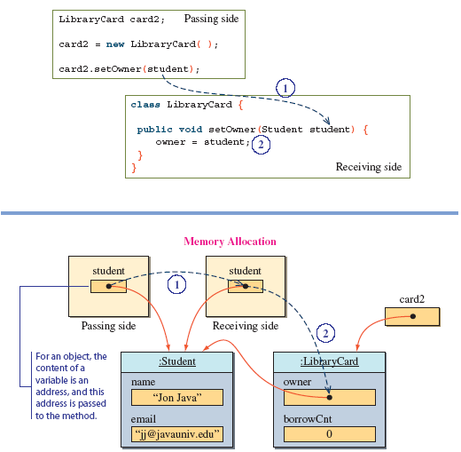
Passing a Student Object

Slide 33
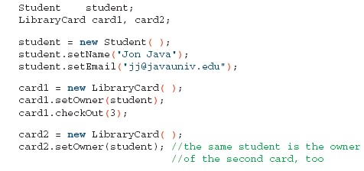
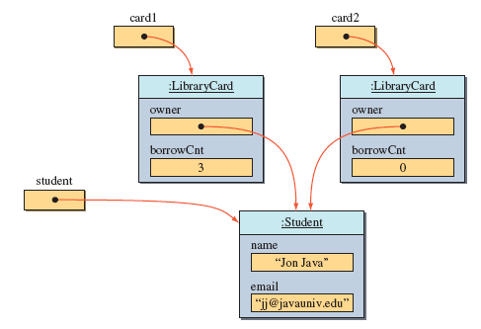
Sharing an Object
We pass the same Student object to card1 and card2
Since we are actually passing a reference to the same object, it results in the owner of two LibraryCard objects pointing to the same Student object
Notes:
Page- 189 to 192
Student, LibraryCard, Librarian classes

Slide 34
Summary
Define concepts of class and object.
Define Fields, Methods and Constructors
Different types of parameter passing in declaration of methods
Different types of return values of methods
How to invoke the methods and method overloading
Define constructors, taking parameters in constructors and overloading constructors

Slide 35
References
An introduction to object-oriented programming with Java (Fifth Edition), C. Thomas Wu
Java 8 Programming Black Book (2015 Edition), DT Editorial Services, Comprehensive Problem Solver.

Slide 36

LET’S DO EXERCISES!

Slide 37


